Slide 1
Fundamentals of Algorithm (FA)
Omkar Basnet
Academic Incharge , CSIT/BCA
Texas international college

Slide 2
Revision of chapter 2:
Calculate the running time of following algorithms:
Evaluating the given number prime or not
Calculating sum of n numbers.
Addition of 2*2 matrix using array
Evaluating given number even or odd

Slide 3
Evaluating given number even or odd
Print (Enter number) // constant time (unit time)== 1
Scan(“%d”,n) // unit time ==1
If(n%10==0) // constant time c
{
print (“even”) //1
}
Else {
Print(“odd”) // 1
}
Total time is 1+1+C+(either if i.e. 1 or else 1) choose larger runtime.
But the complexity of both subroutines are same so
T.C.= 1+1+C+1
O(1)

Slide 4
Chapter three(8 teaching hours)
Analysis of Brute-Force Algorithm
(Running time analysis)
Analysis of Brute-Force maxima Algorithm
Introduction of Plane Sweep Algorithm
Comparison between plane sweep and Brute-Force Algorithm

Slide 5
Analysis of Brute-Force Algorithm
Brute-Force Algorithm
It is straight forward approach to solve a problem , usually based on the problem statement and definition of the concept involved.
Applicable to a very wide variety of problems such as sorting , searching , matrix multiplication , string matching etc.
The analysis of brute-force algorithm can be done in 3-sum technique to find out the unique pair of sets

Slide 6
Brute-Force Algorithm
3-sum technique to find out the unique pair of sets
for(i=0; i<n; i++)
{
for(j=0; j<n; j++)
{
for(k=0; k<n; k++)
{
If (a[i],a[j],a[k]== 0)
{
count ++
}
return (a[i],a[j],a[k]);
}
}
}
The total complexity of 3-sum brute-force algorithm is O(n³)
Space complexity is :
They need to store given sets and the matching status along with number of matching sets so
Space complexity is O(n²).

Slide 7
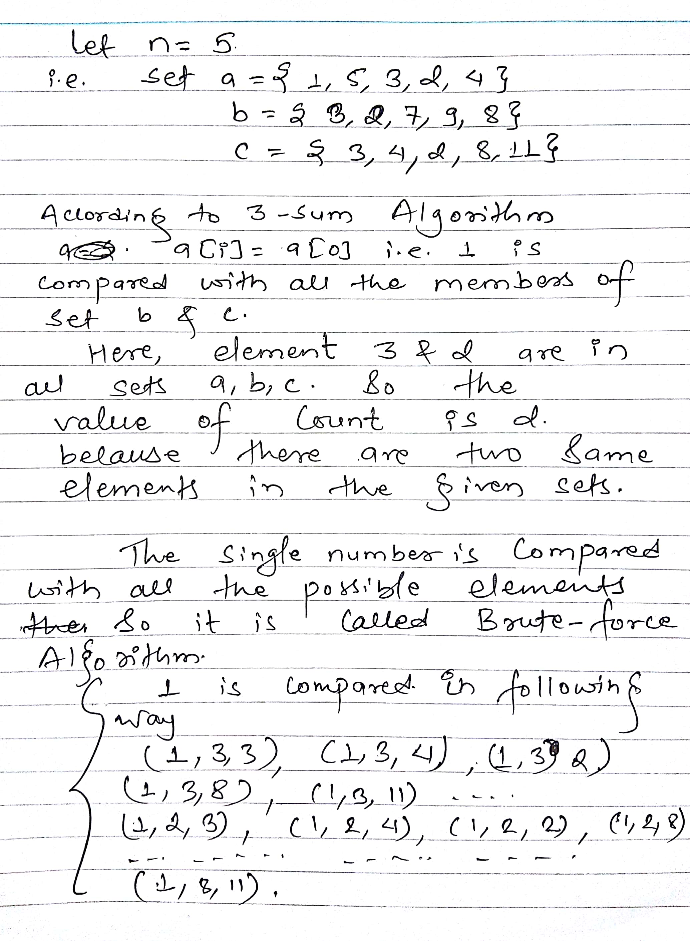
Brute-Force Algorithm
How does it works ???

Slide 8
Brute-Force Algorithm
NOW COMPLETE THIS CLASSWORK
Consider the value of n=3 and trace the Brute-force algorithm.

Slide 9
Brute-Force maxima Algorithm
MAXIMA(int n, print (1…… n)) // maximum of p(0….. n-1)
{
For i=1 to n
{
maximal =TRUE// p[i] is maximum by default
For j = 1 to n
{
If(I != j) AND (P[i].X ≤ p[j].X) AND (P[i].Y ≤ p[j].Y)
{
maximal =FALSE // p[i] is dominated by p[j]
Break;
}}
If (maximal) output p[i] // no one dominate p[i]
}}
In this algorithm we will analyze the 2D maxima algorithm.
The main aim of algorithm is to find out the maximum set/number of first loop i.e.
P[i].X ≥p[j].X Or P[i].Y ≥p[j].Y
Then only produce the output.

Slide 10
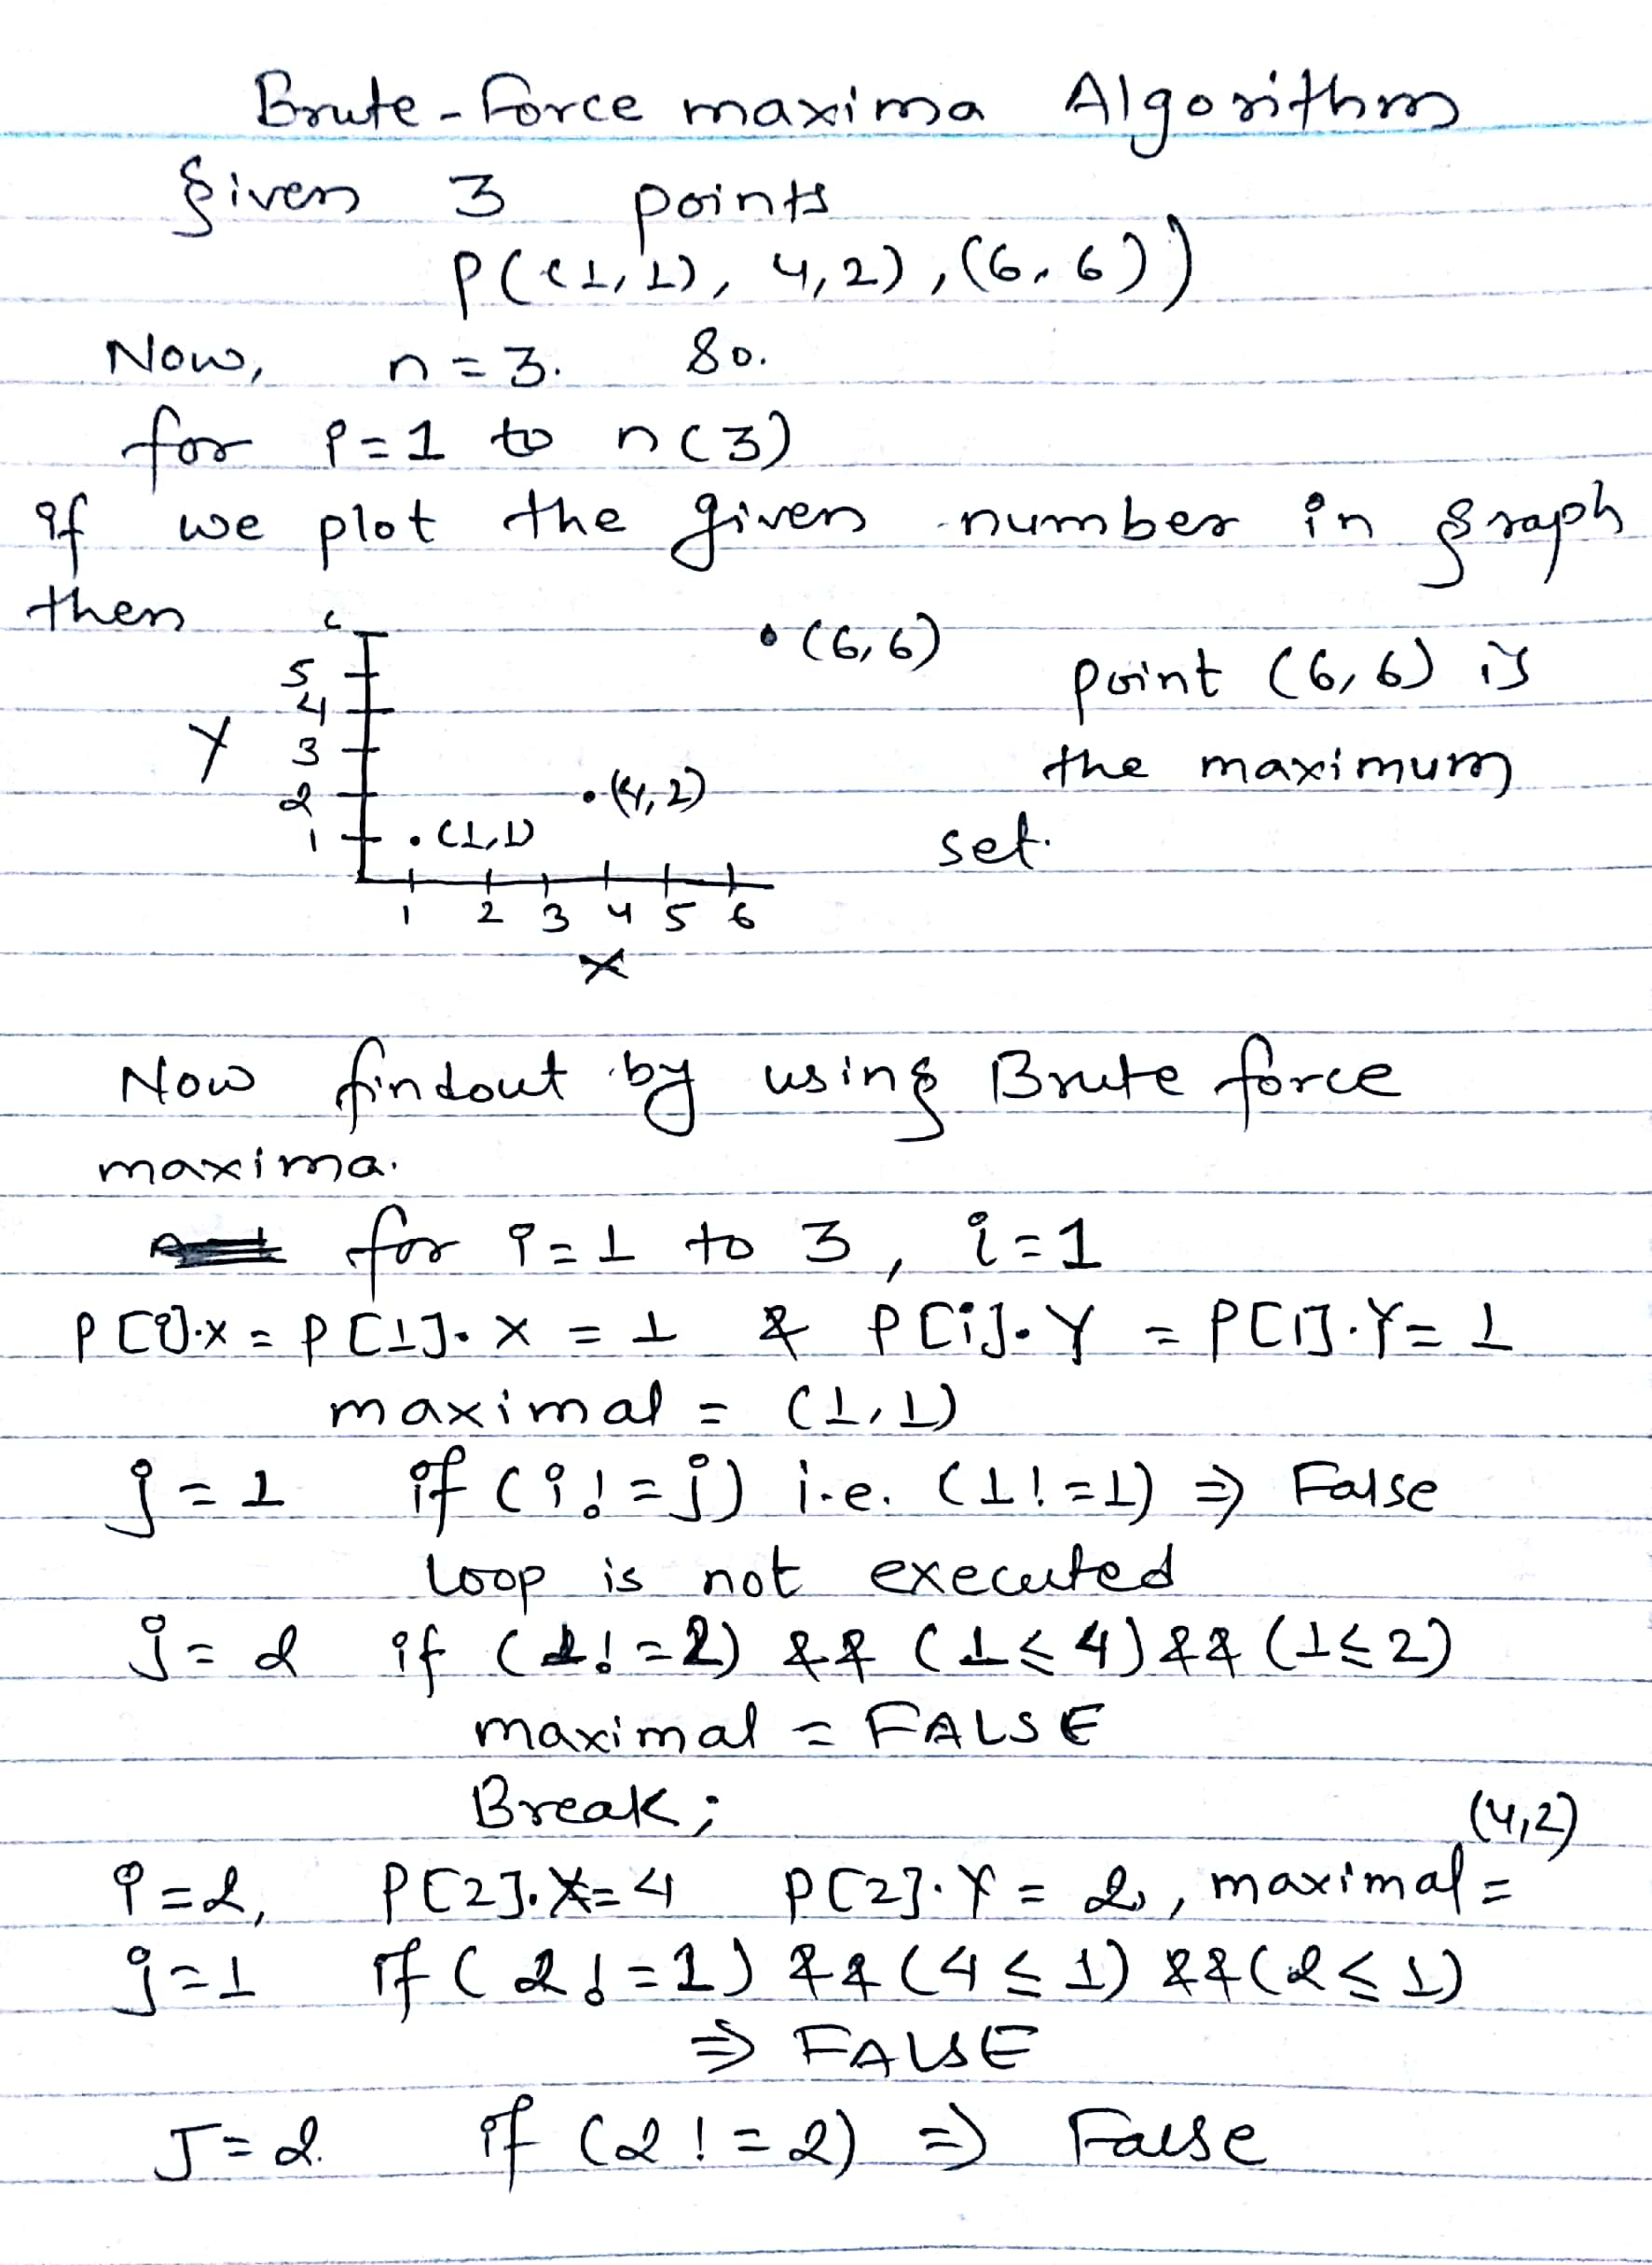
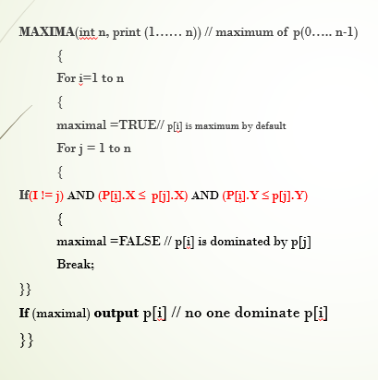
Brute-Force maxima Algorithm

Slide 11
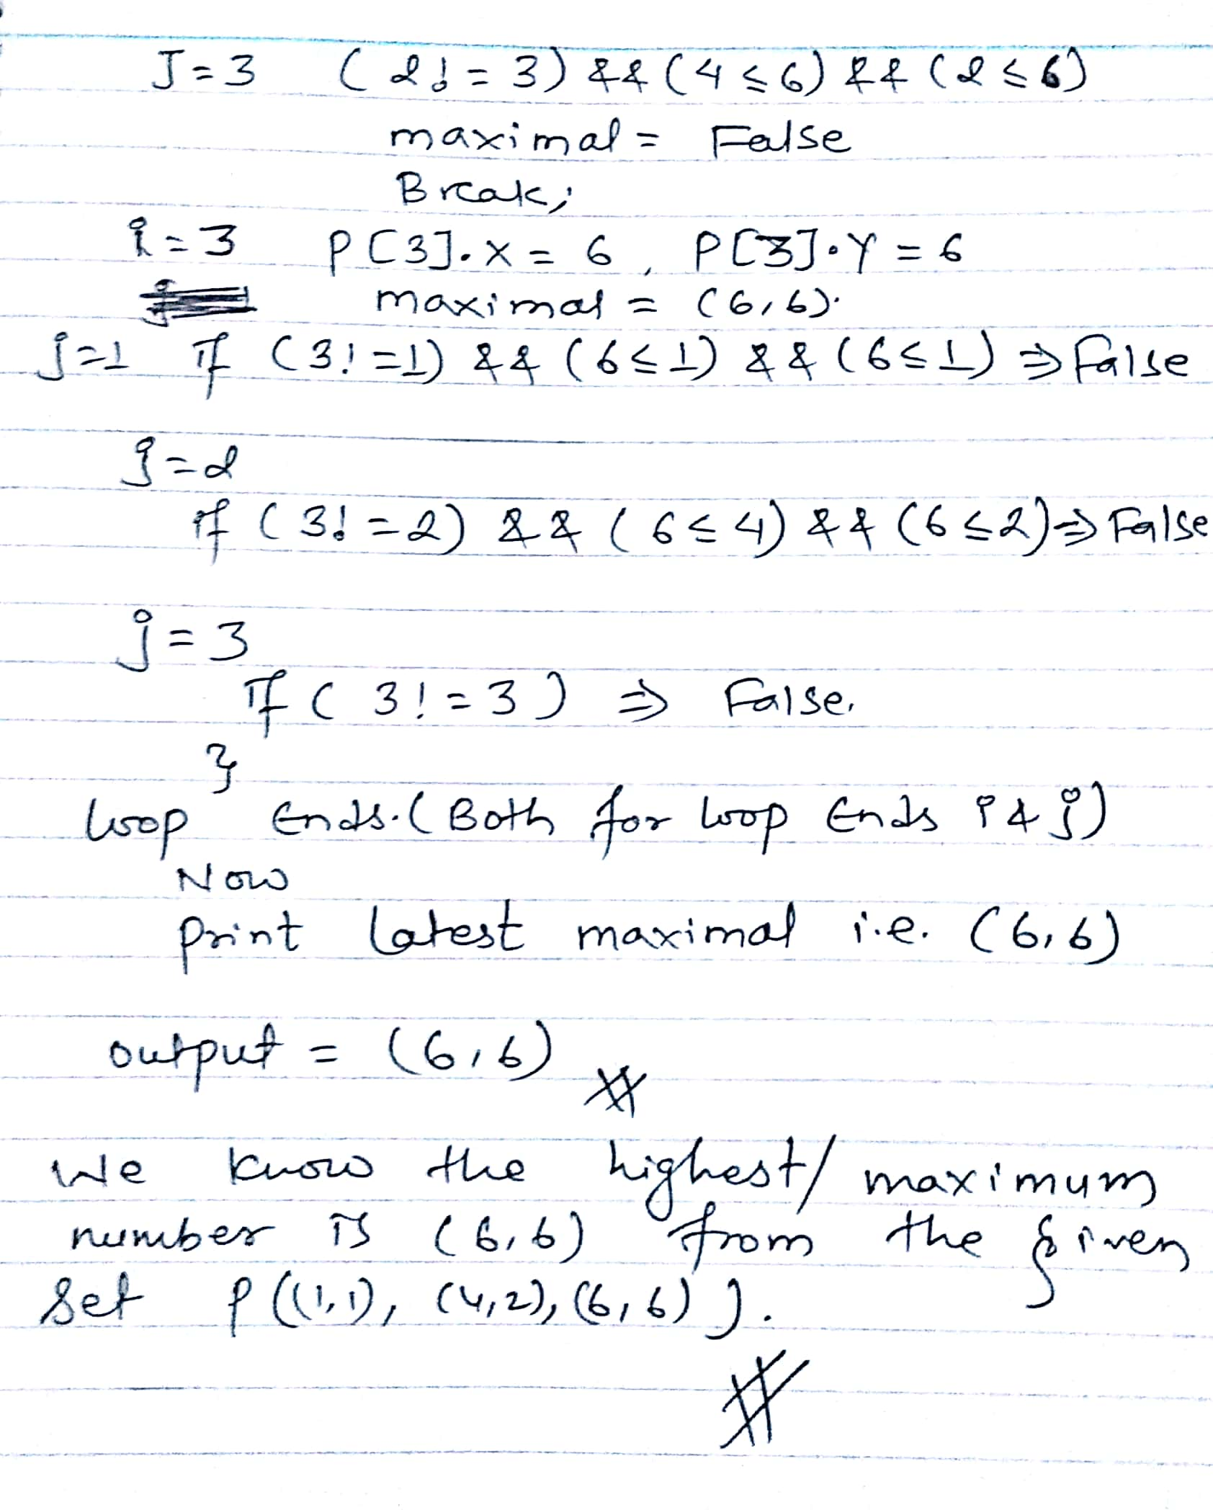
Brute-Force maxima Algorithm

Slide 12
Plane Sweep Algorithm
Working Mechanism
Sweep the vertical line across the plane from left to right.
After sweeping from left to right , we will find out the maximum point sets.
For simplicity we will assume no Y- coordinates are same.

Slide 13
Plane Sweep Algorithm
Algorithm
Plane-sweep –maxima(n, p[1,…….., n])
Sort the p in increasing order of x.
Initialize stack s.
For i=1 to n
DO
While (S.notempty() && s.top.Y< p[i].Y)
DO S.POP()
Do S.PUSH(p[i]
Output The content of STACK
The total complexity of plane sweep algorithm is O(nlogn)

Slide 14
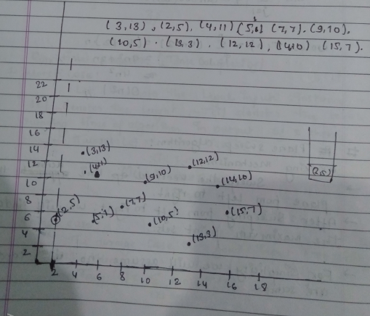
Plane Sweep Algorithm
Algorithm
Plane-sweep –maxima(n, p[1,…….., n])
Sort the p in increasing order of x.
Initialize stack s.
For i=1 to n
DO
While (S.notempty() && s.top.Y< p[i].Y)
DO S.POP()
Do S.PUSH(p[i] )
Output The content of STACK

Slide 15
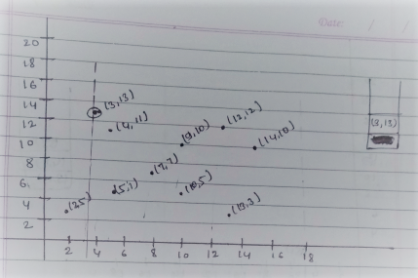
Plane Sweep Algorithm
Algorithm
Plane-sweep –maxima(n, p[1,…….., n])
Sort the p in increasing order of x.
Initialize stack s.
For i=1 to n
DO
While (S.notempty() && s.top.Y< p[i].Y)
DO S.POP()
Do S.PUSH(p[i] )
Output The content of STACK

Slide 16
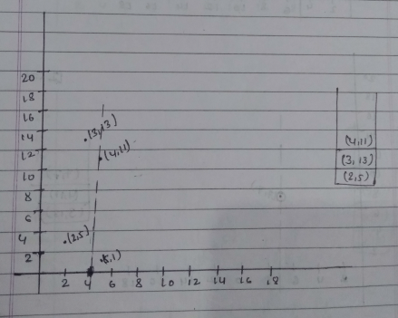
Plane Sweep Algorithm
Algorithm
Plane-sweep –maxima(n, p[1,…….., n])
Sort the p in increasing order of x.
Initialize stack s.
For i=1 to n
DO
While (S.notempty() && s.top.Y< p[i].Y)
DO S.POP()
Do S.PUSH(p[i] )
Output The content of STACK
Note : (2,5) is not the stack
element

Slide 17
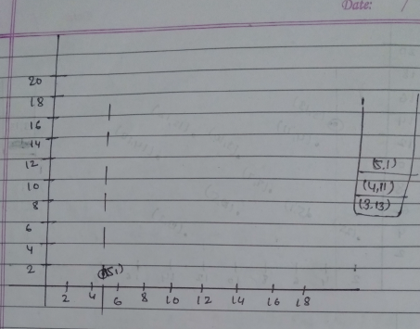
Plane Sweep Algorithm
Algorithm
Plane-sweep –maxima(n, p[1,…….., n])
Sort the p in increasing order of x.
Initialize stack s.
For i=1 to n
DO
While (S.notempty() && s.top.Y< p[i].Y)
DO S.POP()
Do S.PUSH(p[i] )
Output The content of STACK

Slide 18
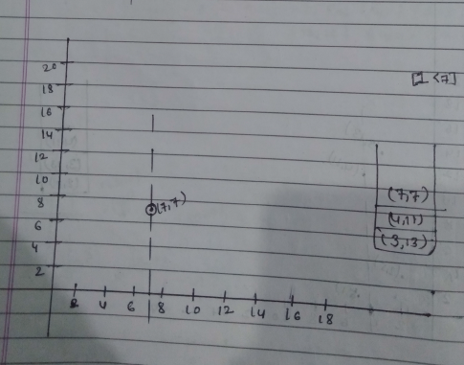
Plane Sweep Algorithm
Algorithm
Plane-sweep –maxima(n, p[1,…….., n])
Sort the p in increasing order of x.
Initialize stack s.
For i=1 to n
DO
While (S.notempty() && s.top.Y< p[i].Y)
DO S.POP()
Do S.PUSH(p[i] )
Output The content of STACK

Slide 19
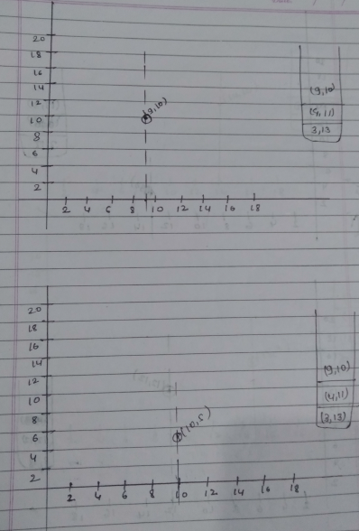
Plane Sweep Algorithm
Algorithm
Plane-sweep –maxima(n, p[1,…….., n])
Sort the p in increasing order of x.
Initialize stack s.
For i=1 to n
DO
While (S.notempty() && s.top.Y< p[i].Y)
DO S.POP()
Do S.PUSH(p[i] )
Output The content of STACK

Slide 20
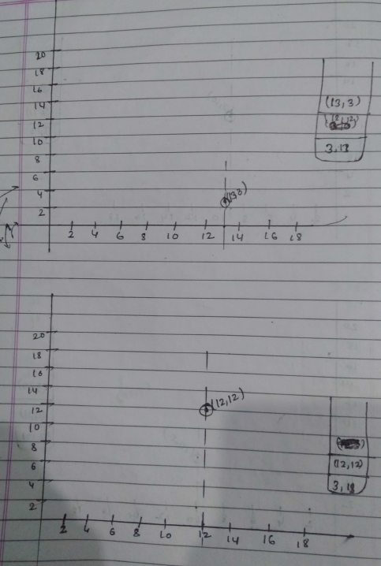
Plane Sweep Algorithm
Algorithm
Plane-sweep –maxima(n, p[1,…….., n])
Sort the p in increasing order of x.
Initialize stack s.
For i=1 to n
DO
While (S.notempty() && s.top.Y< p[i].Y)
DO S.POP()
Do S.PUSH(p[i] )
Output The content of STACK

Slide 21
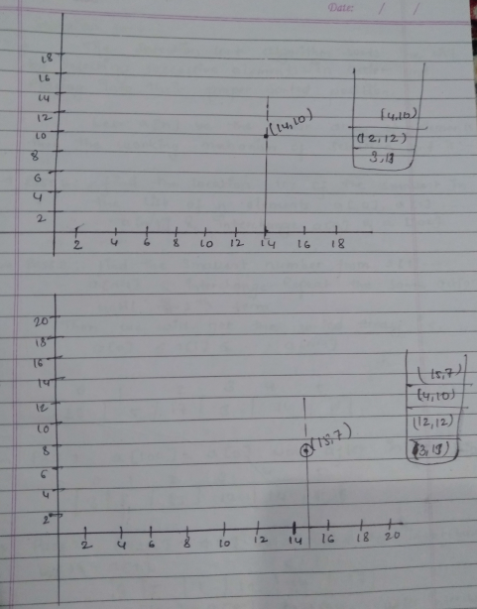
Plane Sweep Algorithm
Algorithm
Plane-sweep –maxima(n, p[1,…….., n])
Sort the p in increasing order of x.
Initialize stack s.
For i=1 to n
DO
While (S.notempty() && s.top.Y< p[i].Y)
DO S.POP()
Do S.PUSH(p[i] )
Output The content of STACK

Slide 22
LETS SEE YOU ON NEXT CLASS

